Slide 1


Sequencing pipelines
NeSI workshop, 11 August 2021
Dr Andrew Wallace

Slide 2
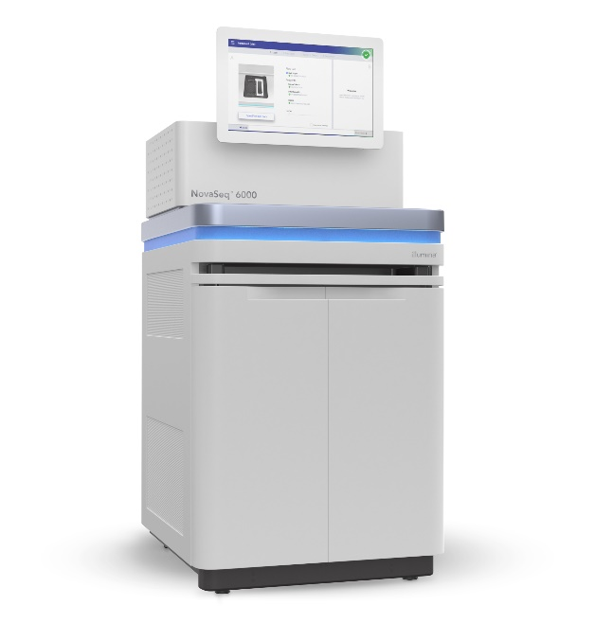

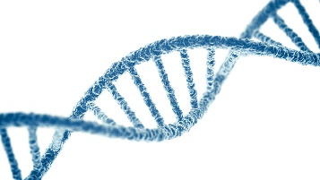
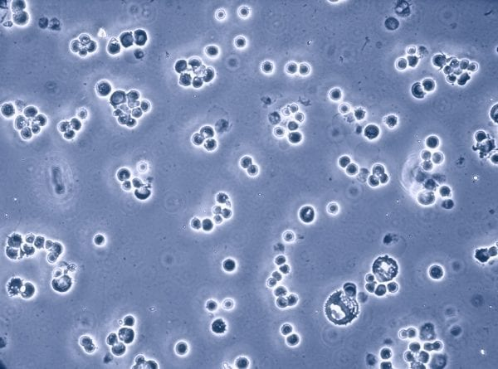


Gathering the data
Sequencing
Genetic material
Extraction
& library prep
Genotyping

Slide 3
Processing the data
Imputing GT: Beagle 5.0
Identification: Kraken2
Limitations:
Need pre-made SNPchips
Can’t discover new variants
Mapping: BWA
Variant calling: BCFtools
Imputing GL: Beagle 4.1
Imputing GT: Beagle 5.0

Slide 4
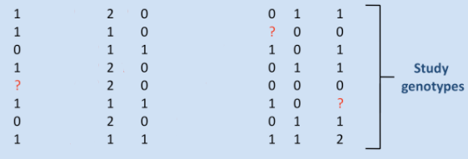
Different types of output data
Sequencing
Genotyping
Reads:
ACACATACGCACTGGGCGTAAAGGGCGCGAGGCGTCGGTGCTCAAAGTCC…
TTGTTAGTCGAGTGTGAAAGCCCTGGGCTTAACCCGGGAAGCGCGTCAGT…
AAGGTCACGTGCAGGGCCTTAACGTGCAGTCCAGGGCAATTTCGAGCTCT…
CGCGTTAATTGCCAGTTGCAGAACGTCCGTTACGTAAACGGTTTTACGTC…
GGGCATGCATGCACGTACGTTGCAACCGTAGGAAGCCTTGACGTTACGTT…

Slide 5
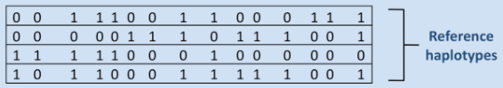
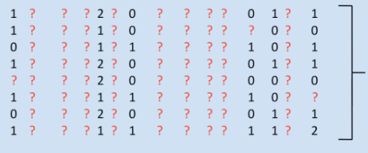
Imputation is guessing the blanks
An imputation program will statistically predict the most likely missing data
The prediction can only be as good as the information you provide
The ‘Reference’ set needs to be statistically representative of the population
Using known data
Infer
Imputation will fill
in the ‘?’ with probable numbers

Slide 6
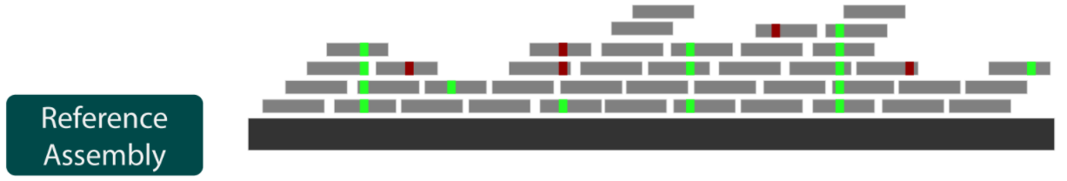
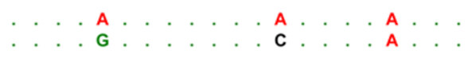
The sequencing pipeline looks a bit different
Reads:
ACACATACGCACTGGGCGTAAAGGGCGCGAGGCGTCGGTGCTCAAAGTCC…
TTGTTAGTCGAGTGTGAAAGCCCTGGGCTTAACCCGGGAAGCGCGTCAGT…
AAGGTCACGTGCAGGGCCTTAACGTGCAGTCCAGGGCAATTTCGAGCTCT…
CGCGTTAATTGCCAGTTGCAGAACGTCCGTTACGTAAACGGTTTTACGTC…
GGGCATGCATGCACGTACGTTGCAACCGTAGGAAGCCTTGACGTTACGTT…
Sequencing gives random tiny pieces of the genome
Computer has to do the jigsaw
‘Mapping’ or ‘Assembly’
Identify places where the samples differ
‘Variant calling’
Mapping to known reference genome
Calling variants,
where sample differs to reference

Slide 7
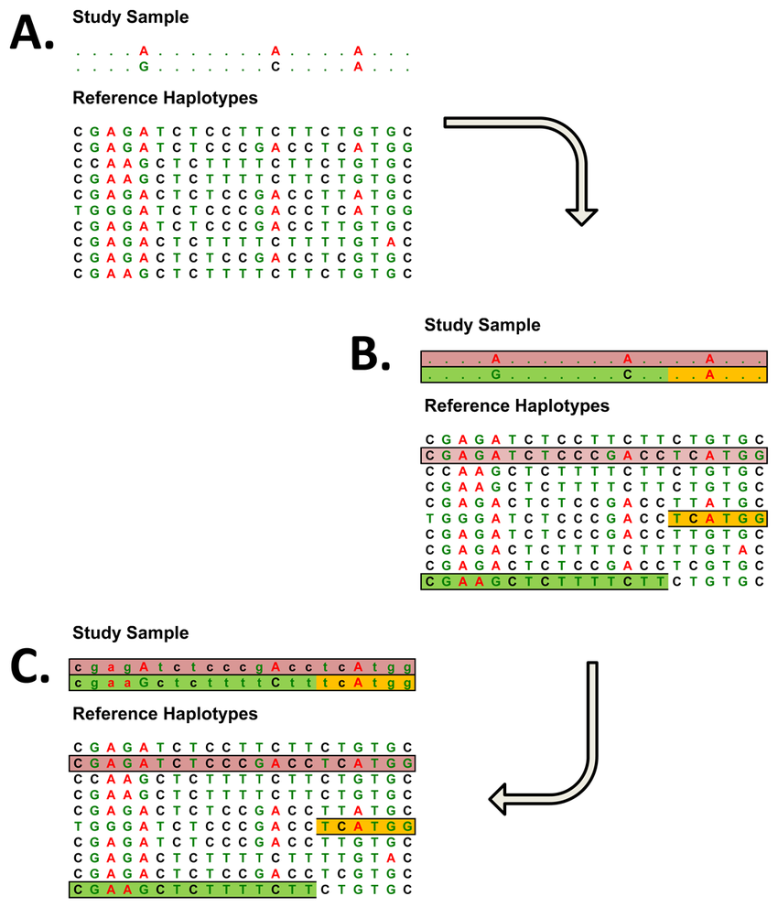
The Imputation step
Imputation program:
Finds the best match(es) in the reference for the sample sequence
Inserts the rest of the reference match into the sample

Slide 8
Typical process for low-pass sequencing
Genetic material
Raw read data:
ACACATACGCACTGGGCGTAAAGGGCGCGAGGCGTCGGTGCTCAAAGTCC…
TTGTTAGTCGAGTGTGAAAGCCCTGGGCTTAACCCGGGAAGCGCGTCAGT…
AAGGTCACGTGCAGGGCCTTAACGTGCAGTCCAGGGCAATTTCGAGCTCT…
CGCGTTAATTGCCAGTTGCAGAACGTCCGTTACGTAAACGGTTTTACGTC…
GGGCATGCATGCACGTACGTTGCAACCGTAGGAAGCCTTGACGTTACGTT…
Data arrives in .fastq.gz format
Readable text, zipped
Lines have ID of read, estimated accuracy, DNA read data in pieces
Typically millions of reads per sample
Quality check
FastQC on NeSI
Analyses each .fastq.gz and generates a .html report on quality of sequence
Takes a few minutes per sample
Don’t panic just because some FastQC metrics are bad
Extraction
Sequencing

Slide 9

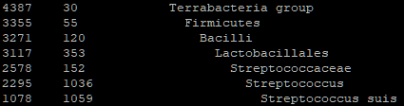

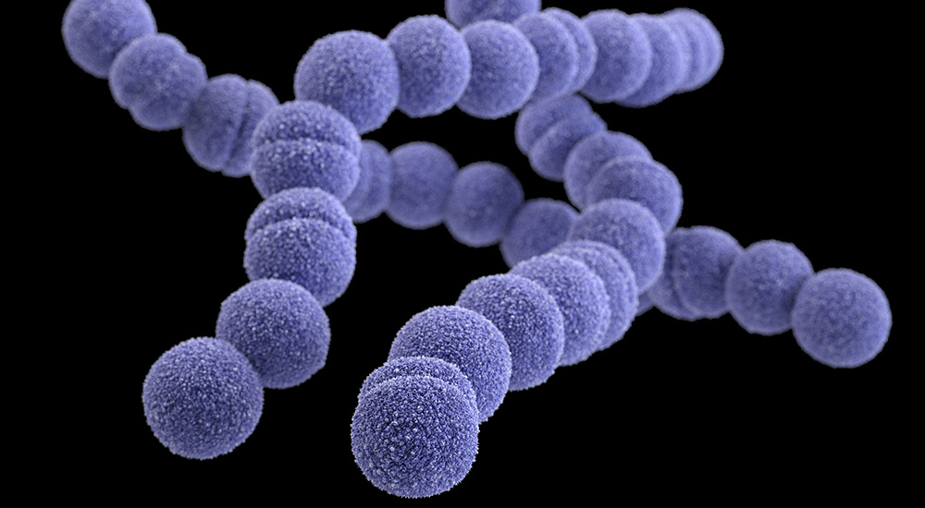
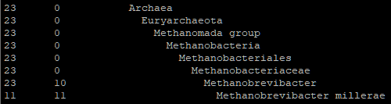

Identifying reads
Identification (optional extra step)
Kraken2 on NeSI can take an hour or two per sample
Requires pre-building a Kraken2 database, by downloading genomes from international sequence databases
Kraken2 can match reads in .fastq.gz files against its database and report what organism they match to
Generates text output for each fastq

Slide 10

Mapping reads
The reads are in tiny pieces in the .fastq.gz file (e.g. 150 base pairs)
Need to get the computer to do the jigsaw and put the pieces together
1. Without a guiding picture on the box
“De Novo Assembly”
Very challenging, time-consuming, error-prone
Avoid unless you have to
Ideally be working with:
a short genome (e.g. bacterial)
that is haploid
Use a technology with long reads (e.g. Oxford Nanopore) for the basic structure (‘scaffolds’) and then one with extremely accurate reads (e.g. Illumina Short Reads) for fixing any small errors (‘polishing’).

Slide 11

Mapping reads
2. With a guiding picture on the box
“Mapping”
Nice and quick,
Need to provide a single ‘reference genome’ box picture that you, or someone else, has assembled (not the same as imputation ‘reference’!!!)
The cow reference genome is ARS-UCD 1.2
Was assembled by experts over many years
Comes from a particular cow in America that was sequenced extremely deeply with a variety of technologies then assembled
Answer: 2,4,7,8
Which pieces don’t map perfectly?

Slide 12
Mapping
BWA or minimap2 on NeSI do the mapping, can take a few hours per sample
Works out where in the reference genome each read sits
Records the read as ‘unmapped’ if it doesn’t fit
Fine to have reads from the wrong species, they’ll remain unmapped
Assigns a quality score to how well the read mapped
S1.fastq.gz
BWA
S1.cram

Slide 13
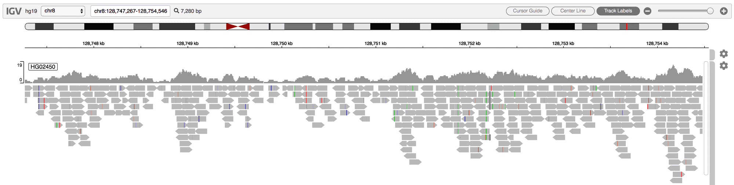
Mapping
Produces a .cram file (or older/less compressed formats .bam or .sam)
Human readable-ish via: samtools view <file> | less
Better viewed in IGV (Integrated Genomics Viewer):

Slide 14
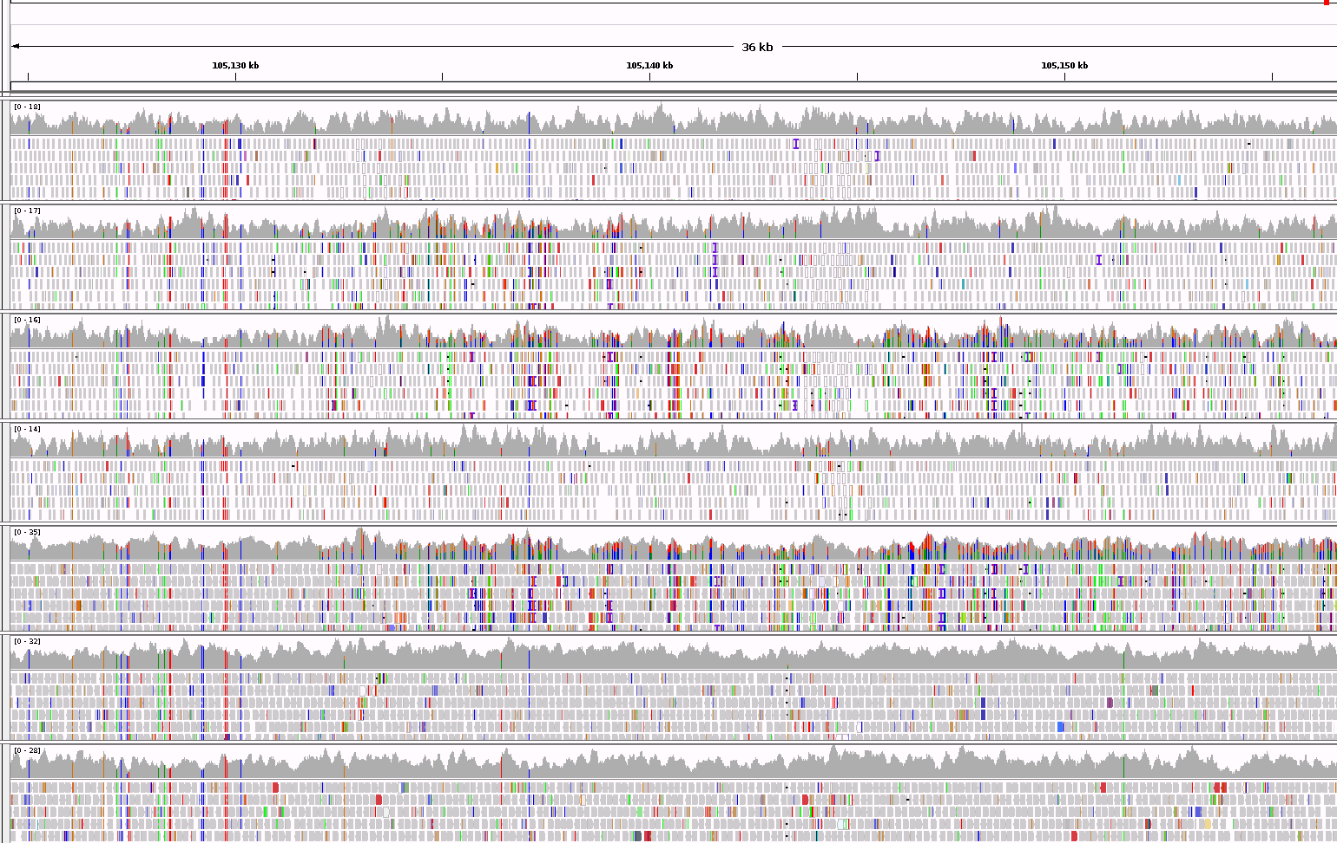

Slide 15
Variant calling
Variant caller program looks for places where samples differ to the supplied reference Analyses the likelihood of:
a sequencing error in the reads
versus
there being a true difference
Variation compared to reference sequence

Slide 16

Variant calling on NeSI
BCFtools or GATK on NeSI to call variants
Calling is done a chromosome at a time, for all samples simultaneously
Consider an array job (1 per chromosome), can take a day per chromosome
The .vcf.gz format is useful and human-readable-ish (zless <file>.vcf.gz)
Fully describes how each sample differs to the reference at each location
S1.cram … S1000.cram
BCFtools
chr1.vcf.gz … chr29.vcf.gz

Slide 17
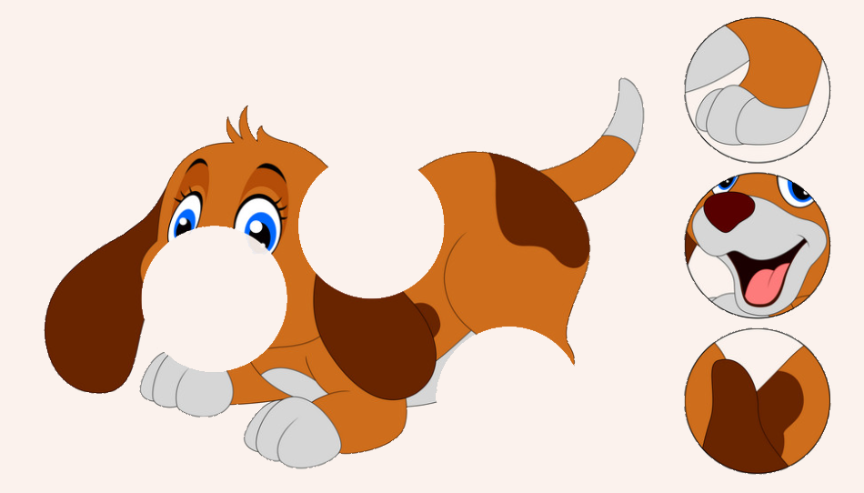
Imputation
Why do imputation in this pipeline?
Some sites may have had no reads land on them (so no data)
Some sites might have only a few reads land on them (so very poor accuracy of variant calls)
Instead of spending much more $$$ to get many more reads from the sequencer, can do imputation
Feed the variant-called chr1.vcf.gz … chr29.vcf.gz files into Beagle to impute
Resource intensive!

Slide 18

Two types of Beagle imputation
1. The fast one
For people working with genotypes panels.
Beagle’s GT algorithm is for filling in missing genotypes
If you are doing genotyping rather than sequencing, this is the one you want
Nice and quick.
Varies with the version:
Beagle 5.0 was a huge improvement on Beagle 4.1.
Regressed a bit with 5.1 initially.
I haven’t tested later versions of 5.1, or 5.2.
S1 | 0 | 1 | 2 | 1 | ? | 1
S2 | 0 | ? | 2 | 1 | 2 | 1
S3 | 1 | 1 | ? | 2 | 2 | ?
S4 | ? | 1 | 0 | 2 | 0 | 1 | …

Slide 19

Two types of Beagle imputation
2. The slow one
For people working with sequence data.
Beagle has a GL algorithm for reanalysing the variant calls.
If you are doing sequencing, you need to run this before you then do the GT algorithm, or else your accuracy will be terrible.
This is because variant calls from sequencing are inaccurate. Beagle needs to do a complex reanalysis of the variant calls taking the haplotypes into account.
This is slow and resource intensive. ~50 years cpu time for ~7000 cow samples.
This is available in Beagle 4.1 but was not implemented in later versions.
“Recent versions of Beagle do not infer genotypes from genotype likelihood input data, but Beagle versions 4.0 and 4.1 have this capability.” – Beagle 5.2 manual
“The GL imputation feature was removed from Beagle 5.0 because version 5 uses a different (much better) phasing algorithm for GT data, and the new phasing algorithm does not naturally extend to handling GL input data. GL imputation is a very hard methodological problem and I think it would be challenging to get funding from my funders to develop methods in this area.” – Brian Browning, author of Beagle, email correspondence

Slide 20
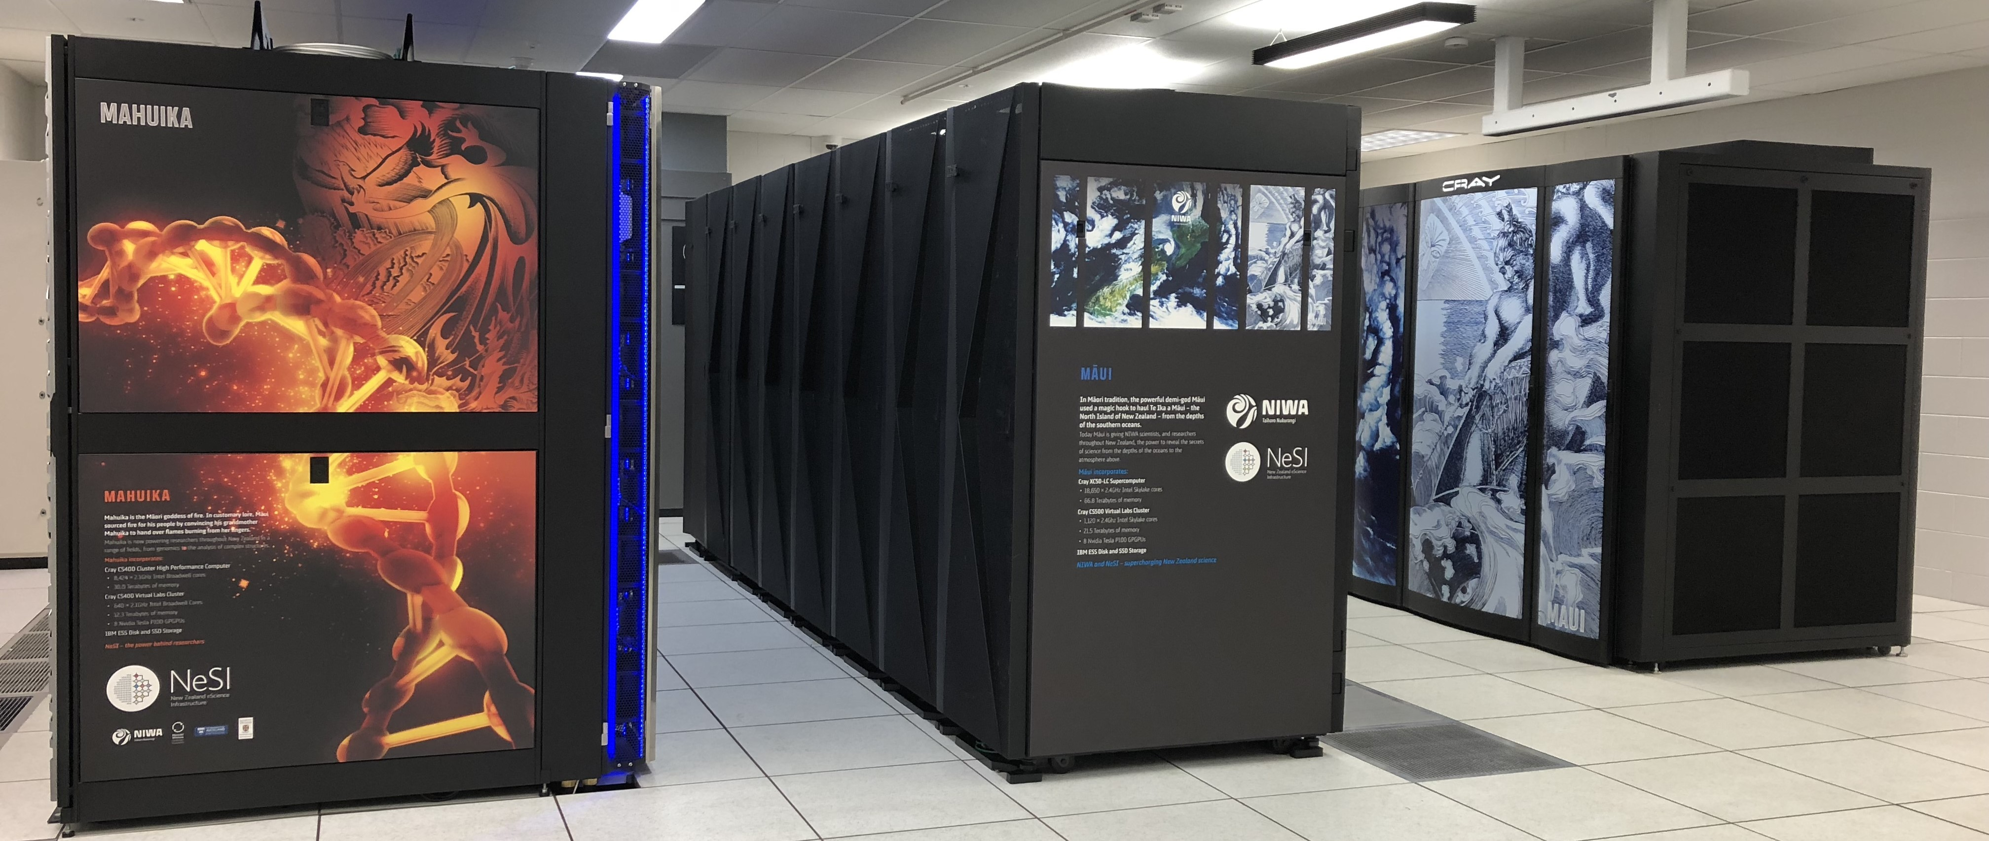
Keeping computational resources feasible
Can easily run out of memory / cpu time with big datasets
If you have issues with resources
Make sure you are only imputing a chromosome at a time
Reduce the size of the reference
A bigger reference isn’t better unless it truly represents the population better
Quality of reference much more important than quantity
Impute a smaller number of samples at a time
As a last resort, split the chromosomes into pieces, impute, and reassemble
Will result in loss of accuracy!

Slide 21
A Typical Pipeline
S1.html…
Quality check: FastQC
S1.fastq.gz…
Species identification: Kraken2
S1.krak…
Mapping: BWA
S1.vcf.gz…
Full genome* of each sample
99% accurate*
S1.cram…
Remerge and unsplit samples: BCFtools
Variant calling: BCFtools
chr1.aa.GTd.vcf.gz … chr1.zz.GTd.vcf.gz …
chr1.vcf.gz … chr29.vcf.gz
Imputing GT: Beagle 5.0
Subsetted into small batches to keep imputation resources low: BCFtools
chr1.aa.GLd.vcf.gz … chr1.zz.GLd.vcf.gz …
chr1.aa.vcf.gz … chr1.zz.vcf.gz …
Imputing GL: Beagle 4.1

Slide 22

User beware
Each individual program in these pipelines
Is not particularly user friendly
Has its own special quirks, and settings
Manuals can be hard going
Needs a lot of testing around resource usage
Can be hard to get right, time consuming, and frustrating

Slide 23
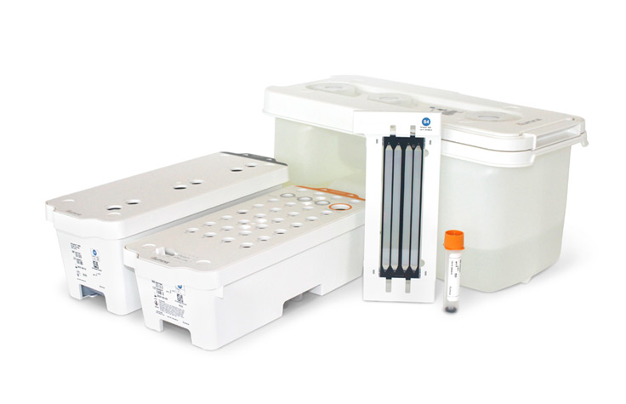
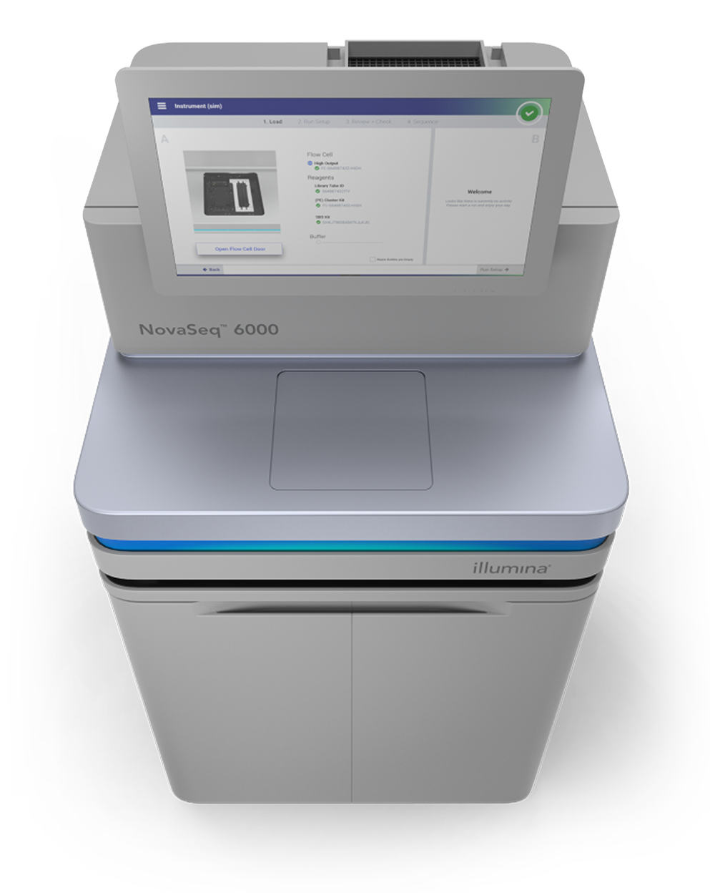
LIC DNA Sequencing Service
LIC accepts customer prepared libraries for sequencing
Our QC ensures optimal cluster generation and maximal data output for each run
A full range of NovaSeq flowcells are available to suit each project
Contact liam.williams@lic.co.nz 027 403 1801

Slide 24
Summary
Imputing GT: Beagle 5.0
Identification: Kraken2
Mapping: BWA
Variant calling: BCFtools
Imputing GL: Beagle 4.1
Imputing GT: Beagle 5.0

Slide 25

Questions?

